Slide 1


Slide 2
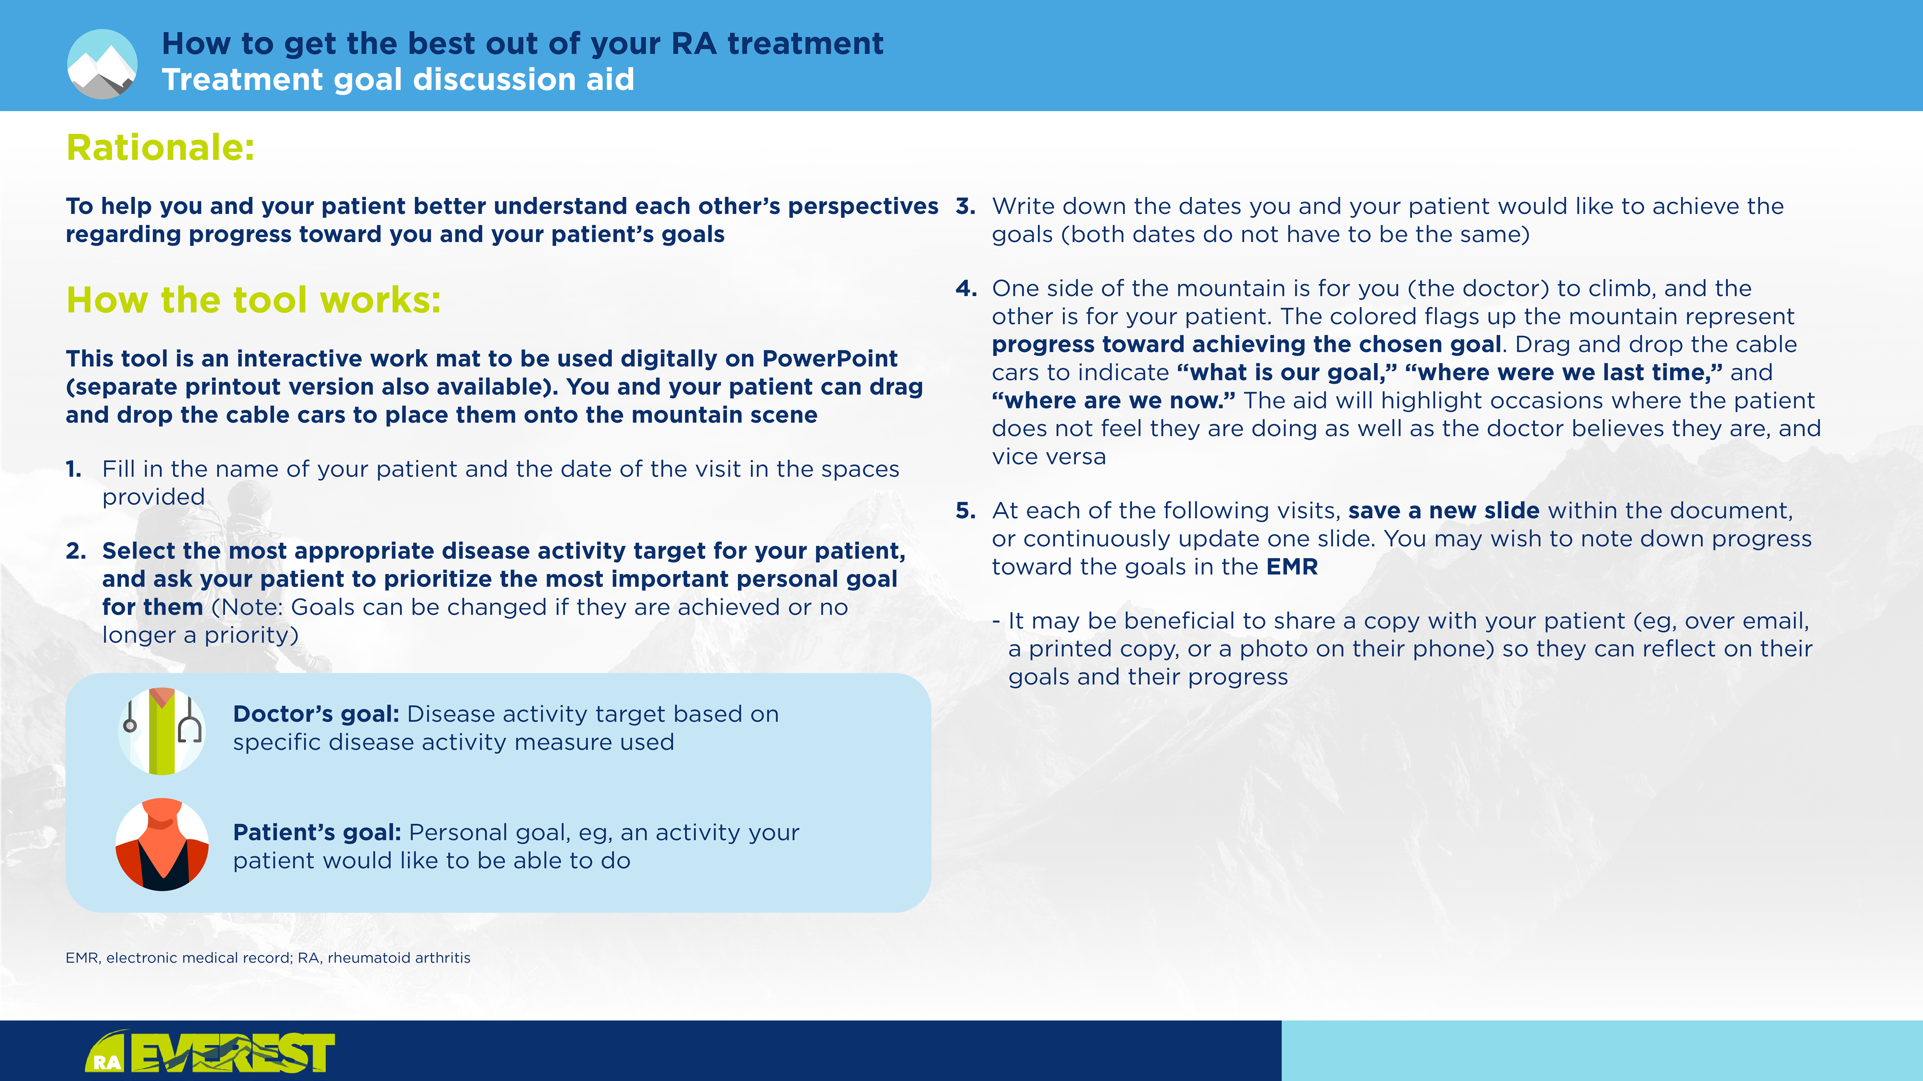

Slide 3

Patient’s name: |  | Patient number:
Doctor’s name: |  | Date:
Doctor’s goal
(based on disease activity measures):
Patient’s goal (choose the most important goal for you right now):
(Think about how you want to improve your quality of life and specific goals you want to work toward)
Date to achieve patient’s goal:
Date to achieve goal: | Please highlight one from each row
Disease activity measure | CDAI SDAI DAS28-CRP DAS28-ESR Other (please specify):
Target | Remission Low disease activity Other (please specify):
Categories | Suggested areas to consider (please highlight one) | Specific details (please add below)
Physical wellbeing | Daily activities (eg, shopping, cleaning)
 | Independence/mobility
 | Quality of sleep; fatigue
 | Exercise/sport
 | Pain
 | Weight loss or gain; appetite
 | Other
Emotional wellbeing | Stress/mental wellbeing
 | Concern over appearance
 | Mood (eg, loneliness, feeling down or misunderstood)
 | Other
Social life | Hobbies
 | Family, friends, and other relationships
 | Travel, going out
 | Other
Work life and study | Study and student life
 | Applying for, keeping, or switching, a job
 | Traveling to and from work
 | Daily tasks, work performance
 | Other
Personal | Self-care: Personal hygiene, getting dressed
 | Intimacy (eg, sexual intimacy)
 | Pregnancy
 | Caregiving
 | Other
Disease activity | Remission
 | Low disease activity
 | Other
Other
CDAI, Clinical Disease Activity Index; CRP, C-reactive protein; DAS28, Disease Activity Score in 28 joints; ESR, erythrocyte sedimentation rate; SDAI, Simple Disease Activity Index

Slide 4
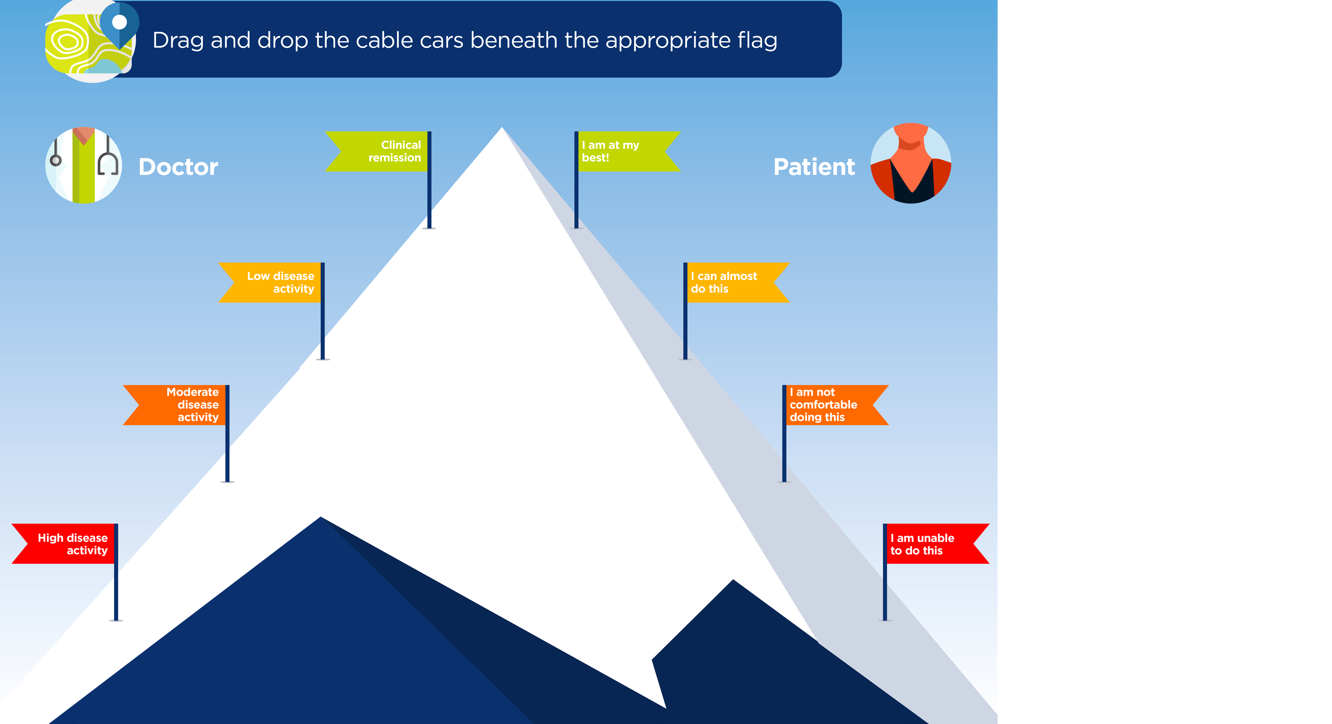
What is our goal?
Where were we last time?
Date of previous visit:
Where are we now?
Today’s date:

